Slide 1

Object oriented programming
Notes:
Are your classroom colors different than what you see in this template? That’s OK! Click on Design -> Variants (the down arrow) -> Pick the color scheme that works for you!
Feel free to change any “You will…” and “I will…” statements to ensure they align with your classroom procedures and rules!

Slide 2
Java Arrays

Slide 3



Java Arrays
Array is a fundamental construct in Java that allows you to store and access large number of values conveniently.

Slide 4


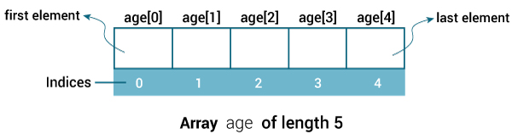
Java Arrays

Slide 5
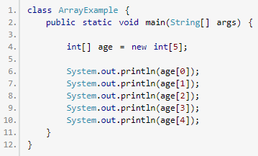
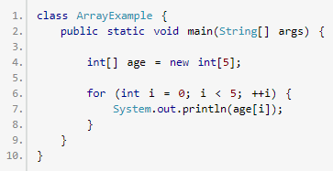
Java Arrays

Slide 6


Java Arrays

Slide 7
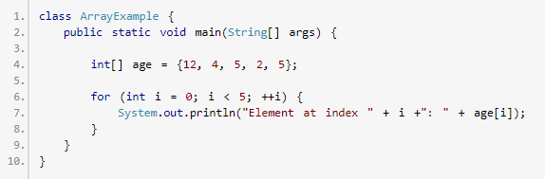
Java Arrays

Slide 8
Exercise-01
Write a program which computes sum and average of values stored in an array.

Slide 9
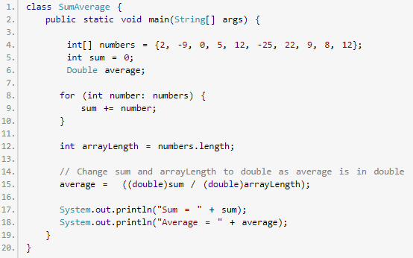
Java Arrays

Slide 10
Exercise-02
Find largest element in an array?

Slide 11
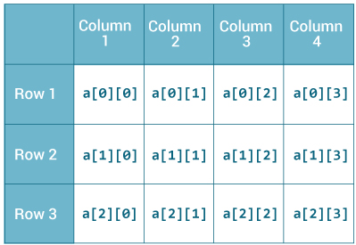

Java Arrays

Slide 12
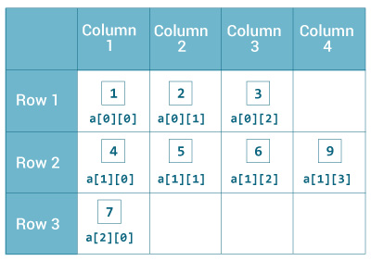
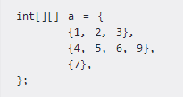
Java Arrays

Slide 13
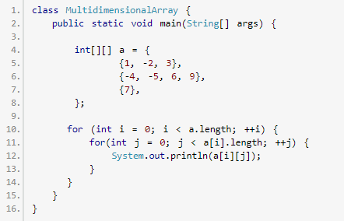
Java Arrays

Slide 14
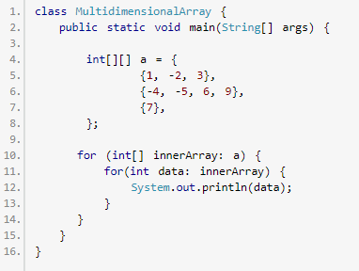
Java Arrays

Slide 15
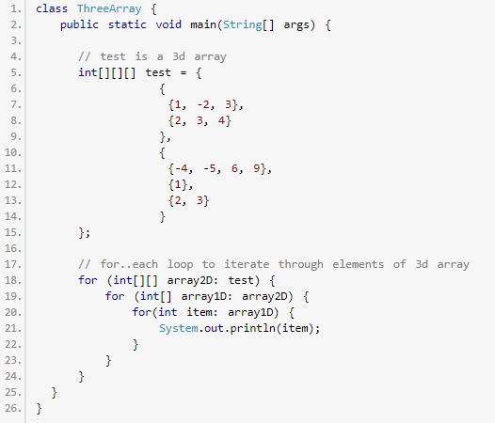
Java Arrays

Slide 16
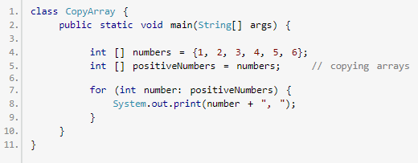
Java Arrays

Slide 17
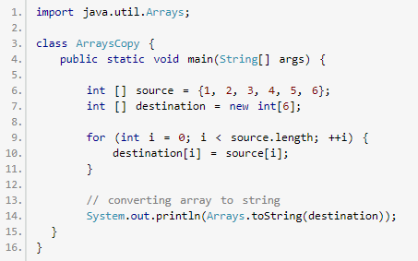
Java Arrays

Slide 18
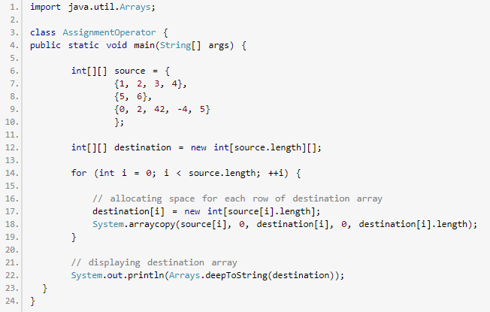
Java Arrays

Slide 19
Assignment
Write a Java Program to Check if An Array Contains a Given Value?
Write a Java Program to Find Transpose of a Matrix?

